Slide 1
Fundamentals of Ecology
Week 8, Ecology Lecture 6
Cara Brook
February 25, 2025
Office hours: On ZOOM
Friday, Feb 28, 2025
4-5pm
I will email out a link!

Slide 2
Learning objectives from Lecture 5
You should be able to:
Recognize which components of the Lotka-Volterra competition equation correspond to intraspecies interactions vs. interspecies interactions.
Analyze nullclines from the competition equations and predict, from the shape of the graph, which equilibrium the two populations will eventually move to, given a starting point.
Given a set of competition equations and a graph of nullclines with variables labeled, understand which nullcline corresponds to which species.
Understand niche partitioning, character displacement, and why these processes occur

Slide 3
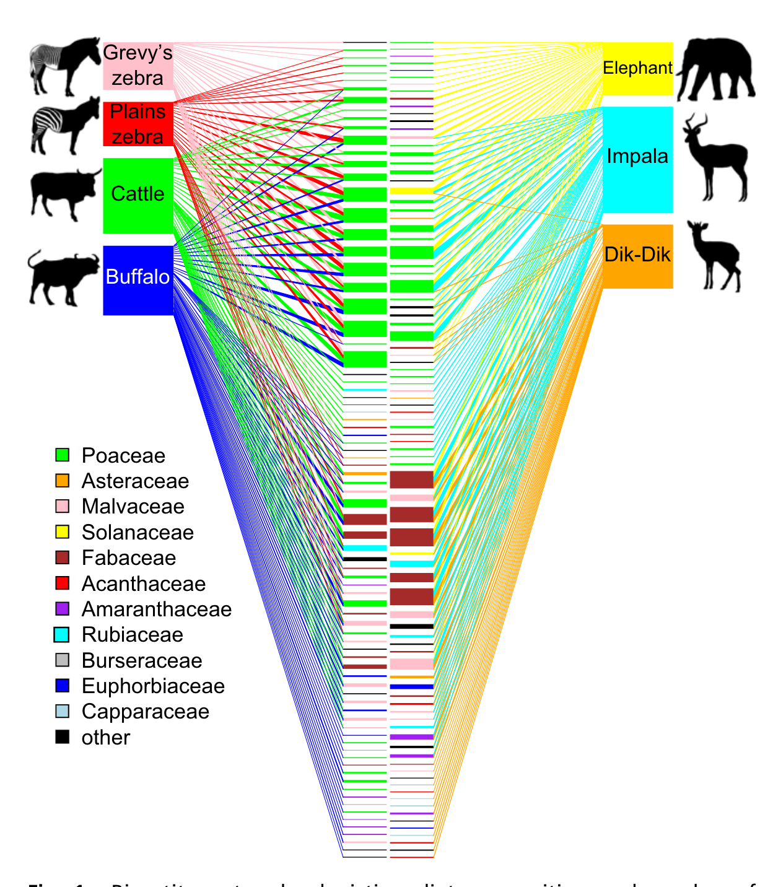
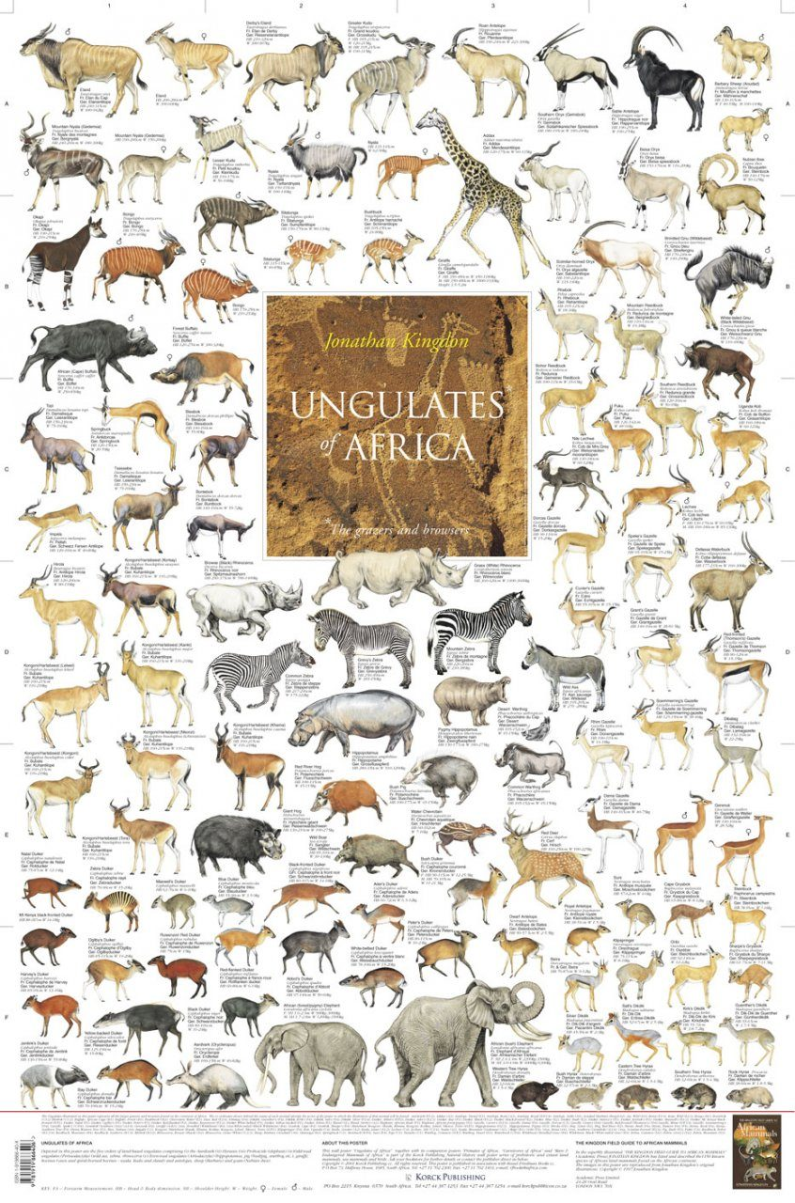
Niche partitioning enables organisms to avoid competitive exclusion
Often 10-25 large mammalian herbivores coexisting in the same African savanna!
Kartzinel et al. 2015. PNAS.

Slide 4
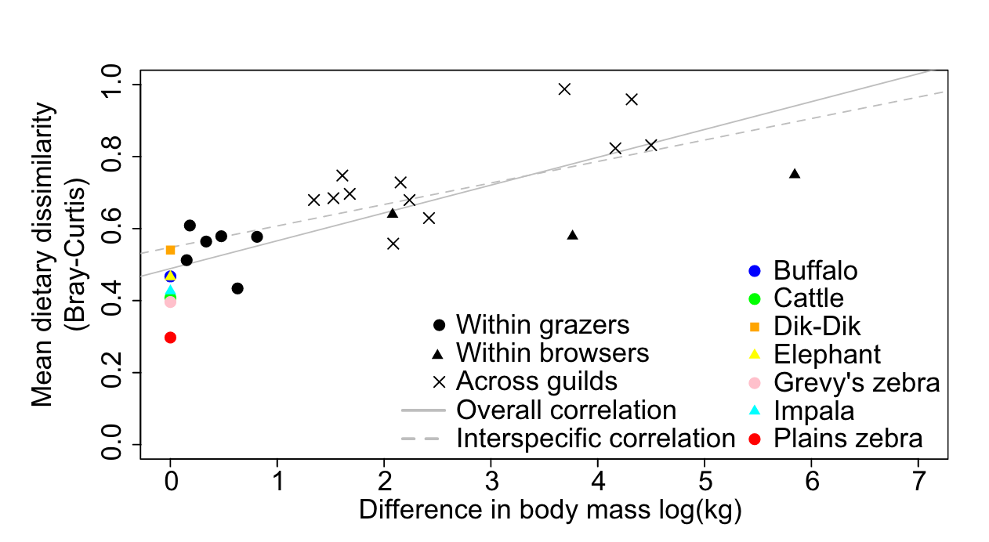
Niche partitioning enables organisms to avoid competitive exclusion
Dietary overlap is higher in similar-sized mammals
Kartzinel et al. 2015. PNAS.

Slide 5
Niche partitioning enables organisms to avoid competitive exclusion
Grazer
(generalist)
Dietary overlap is higher in similar-sized mammals
Browser
(specialist)
Kartzinel et al. 2015. PNAS.

Slide 6
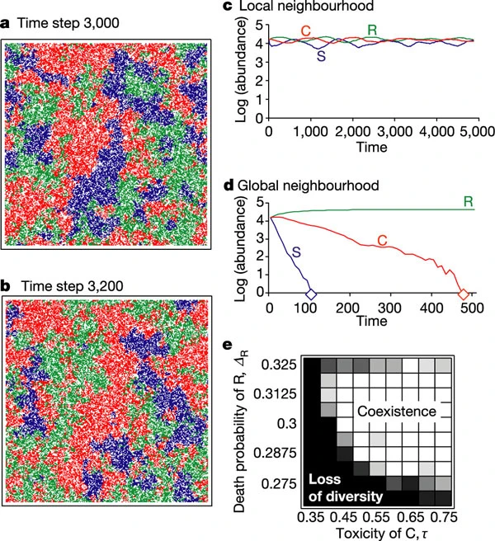
Sometimes stochasticity and space are all you need to ensure coexistence in a competitive environment
Kerr et al. modeled a community of 3 strains of E. coli with overlapping resource requirements (C,R, and S), occupying distinct spatial patches in a metapopulation.
They produced simulations allowing for a perfectly mixed population (global neighborhood), or a population in which dispersal (mixing) happened only locally. allowed to disperse only locally.
Local interactions allowed for the coexistence of all three strains (in theory). Experimentally?
Kerr et al. 2002. Nature.
Notes:
(remember metapopulations!

Slide 7
Sometimes stochasticity and space are all you need to ensure coexistence in a competitive environment
The authors modeled a community of 3 strains of E. coli with overlapping resource requirements (C,R, and S), occupying distinct spatial patches in a metapopulation.
They produced simulations allowing for a perfectly mixed population (global neighborhood), or a population in which dispersal (mixing) happened only locally.
Local interactions allowed for the coexistence of all three strains (in theory). What about experimentally?
Kerr et al. 2002. Nature.
Notes:
(remember metapopulations!

Slide 8
Sometimes stochasticity and space are all you need to ensure coexistence in a competitive environment
The authors modeled a community of 3 strains of E. coli with overlapping resource requirements (C,R, and S), occupying distinct spatial patches in a metapopulation.
They produced simulations allowing for a perfectly mixed population (global neighborhood), or a population in which dispersal (mixing) happened only locally.
Local interactions allowed for the coexistence of all three strains (in theory). What about experimentally?
Kerr et al. 2002. Nature.
Notes:
(remember metapopulations!

Slide 9
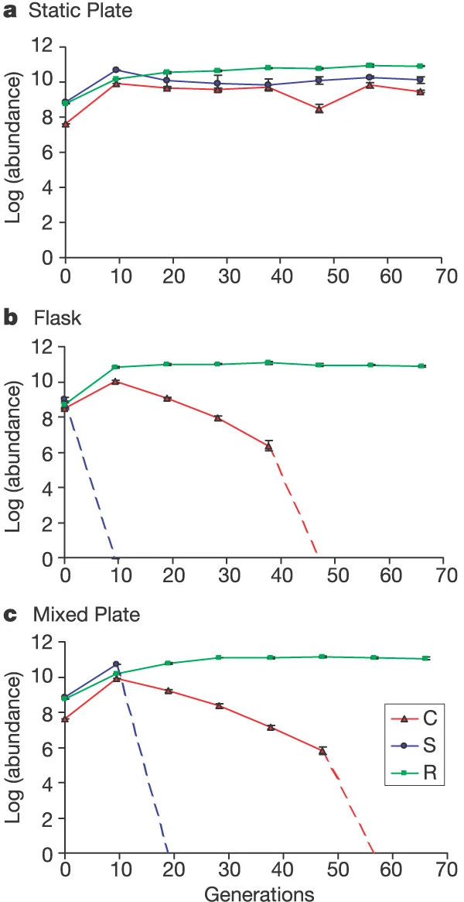
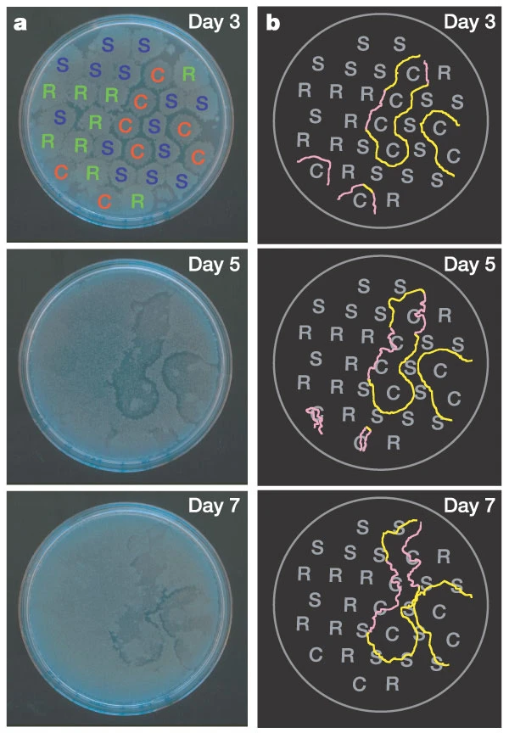
Sometimes stochasticity and space are all you need to ensure coexistence in a competitive environment
spatially structured
perfectly mixed
in-between
Kerr et al. 2002. Nature.

Slide 10
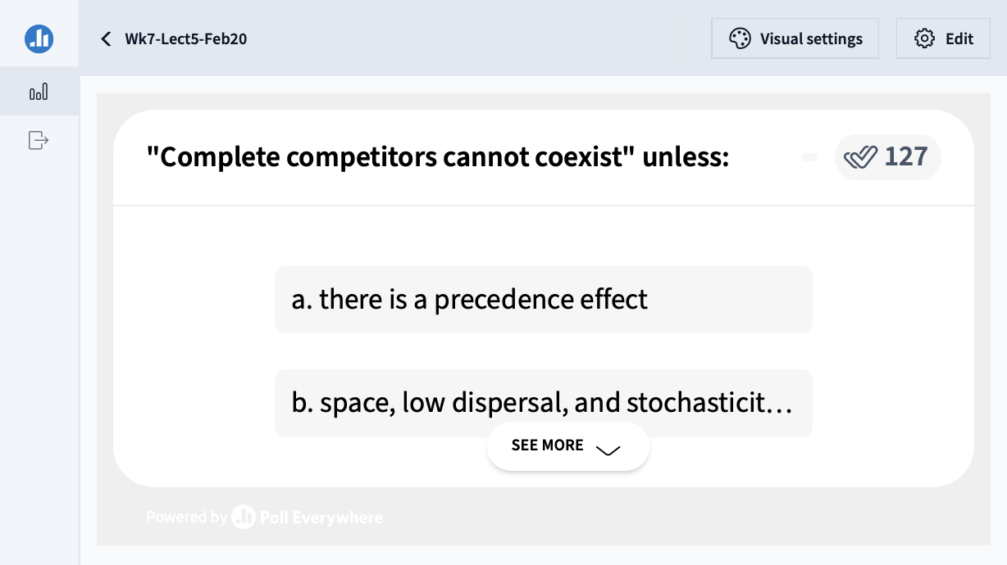

Slide 11
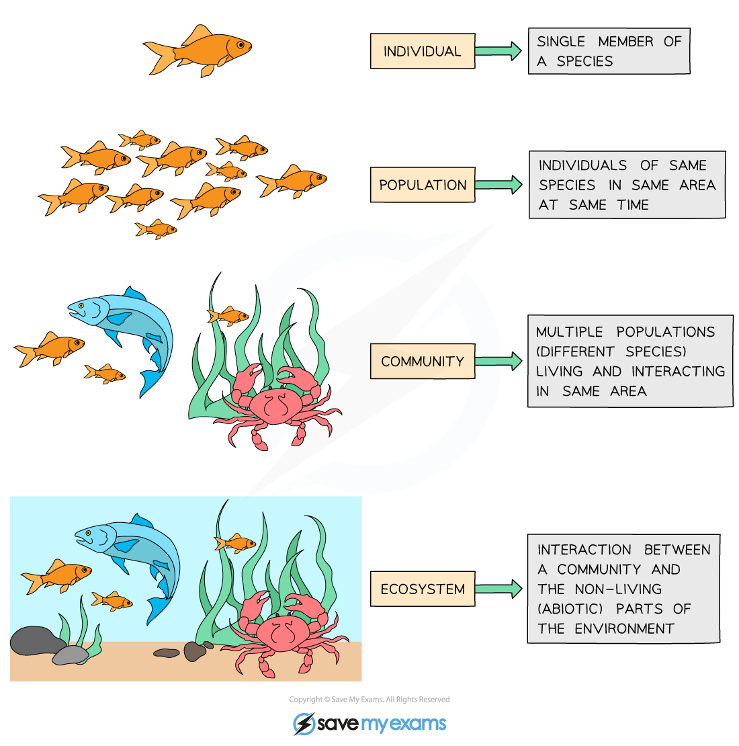
Community = interacting populations of different species
individual
population
fish
(x)
metapopulation
shark
(y)
community
How does fish abundance vary with changes in shark abundance?
ecosystem

Slide 12
Community = interacting populations of different species
individual
population
$$α_{12}$$
$$r_{1}$$
metapopulation
Fish A
(x₁)
Fish B
(x₂)
$$r_{2}$$
community
$$α_{21}$$
How does the abundance of fish species A vary with changes in the abundance of fish species B?
ecosystem

Slide 13
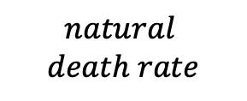
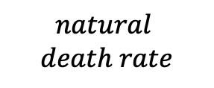
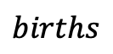
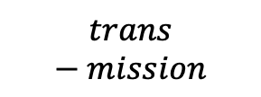
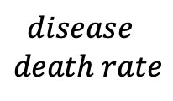
Community = interacting populations of different species
individual
population
$$births$$
Healthy
Fish
(susceptible)
$$trans−mission$$
Sick Fish (infected)
$$disease$$
$$death rate$$
metapopulation
$$natural$$
$$death rate$$
$$natural$$
$$death rate$$
community
How does the abundance of fish change based on infection with Mycobacterium marinum (wasting disease)?
ecosystem

Slide 14
Community = interacting populations of different species
$$births$$
Healthy
Fish
(susceptible)
$$trans−mission$$
Sick Fish (infected)
$$disease$$
$$death rate$$
$$natural$$
$$death rate$$
$$natural$$
$$death rate$$
How does the abundance of fish change based on infection with Mycobacterium marinum (wasting disease)?

Slide 15
Species can interact in several distinct ways.
Community = interacting populations of different species
$$births$$
Mutualism – both species benefit
Commensalism – one species benefits, the other is unaffected
Predation – one species benefits, the other is harmed (eaten!)
Competition – two species compete for the same limiting resource, both harmed by the interaction
Direct = wolves and coyote at a moose carcass
Indirect = diurnal cheetah, nocturnal leopard at a giraffe carcass
Parasitism – one species (the parasite) lives in or on the other species (the host)
Healthy
Fish
(susceptible)
$$trans−mission$$
Sick Fish (infected)
$$disease$$
$$death rate$$
$$natural$$
$$death rate$$
$$natural$$
$$death rate$$
How does the abundance of fish change based on infection with Mycobacterium marinum (wasting disease)?

Slide 16
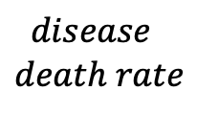
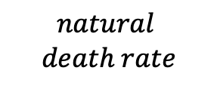
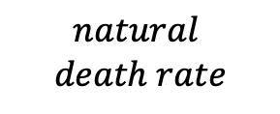
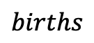
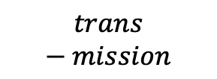
Each box is a distinct population! When we model these populations, everyone in the box is considered the same. In a continuous time model (ODE), each box would get its own differential equation!
Population Biology
$$births$$
Healthy
Fish
(susceptible)
$$trans−mission$$
Sick Fish (infected)
$$disease$$
$$death rate$$
$$natural$$
$$death rate$$
$$natural$$
$$death rate$$
How does the abundance of fish change based on infection with Mycobacterium marinum (wasting disease)?

Slide 17
Each box is a distinct population! When we model these populations, everyone in the box is considered the same. In a continuous time model (ODE), each box would get its own differential equation!
Population Biology
$$births$$
Healthy
Fish
(susceptible)
$$trans−mission$$
Sick Fish (infected)
$$disease$$
$$death rate$$
$$natural$$
$$death rate$$
$$natural$$
$$death rate$$
How does the abundance of fish change based on infection with Mycobacterium marinum (wasting disease)?

Slide 18
Each box is a distinct population! When we model these populations, everyone in the box is considered the same. In a continuous time model (ODE), each box would get its own differential equation!
Population Biology
$$births$$
Healthy
Fish
(susceptible)
$$trans−mission$$
Sick Fish (infected)
$$disease$$
$$death rate$$
$$natural$$
$$death rate$$
$$natural$$
$$death rate$$
How does the abundance of fish change based on infection with Mycobacterium marinum (wasting disease)?

Slide 19
Each box is a distinct population! When we model these populations, everyone in the box is considered the same. In a continuous time model (ODE), each box would get its own differential equation!
Population Biology
$$births$$
Solid lines are processes by which individuals in each population move between boxes.
Dashed lines are influences of populations on rates (transmission is higher when there are more sick fish)
Healthy
Fish
(susceptible)
$$trans−mission$$
Sick Fish (infected)
$$disease$$
$$death rate$$
$$natural$$
$$death rate$$
$$natural$$
$$death rate$$
How does the abundance of fish change based on infection with Mycobacterium marinum (wasting disease)?

Slide 20
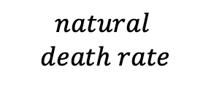
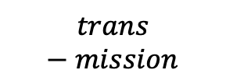
Each box is a distinct population! When we model these populations, everyone in the box is considered the same. In a continuous time model (ODE), each box would get its own differential equation!
Population Biology
$$births$$
Solid lines are processes by which individuals in each population move between boxes.
Dashed lines are influences of populations on rates (transmission is higher when there are more sick fish)
Healthy
Fish
(susceptible)
Sick Fish (infected)
$$disease$$
$$death rate$$
$$trans−mission$$
$$natural$$
$$death rate$$
$$natural$$
$$death rate$$
How does the abundance of fish change based on infection with Mycobacterium marinum (wasting disease)?

Slide 21

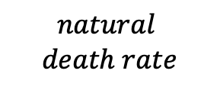
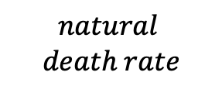
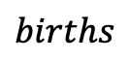
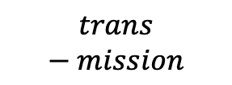
Population Biology
$$births$$
How does the abundance of fish change based on infection with Mycobacterium marinum (wasting disease)?
Healthy
Fish
(susceptible)
$$trans−mission$$
Sick Fish (infected)
$$disease$$
$$death rate$$
$$natural$$
$$death rate$$
$$natural$$
$$death rate$$
In disease ecology, we model populations based on their infection status.

Slide 22
Population Biology
$$births$$
How does the abundance of fish change based on infection with Mycobacterium marinum (wasting disease)?
Healthy
Fish
(susceptible)
$$trans−mission$$
Sick Fish (infected)
$$disease$$
$$death rate$$
$$natural$$
$$death rate$$
$$natural$$
$$death rate$$
Previously, we modeled populations of different species, or of distinct life history classes within a species.
In disease ecology, we model populations based on their infection status.

Slide 23
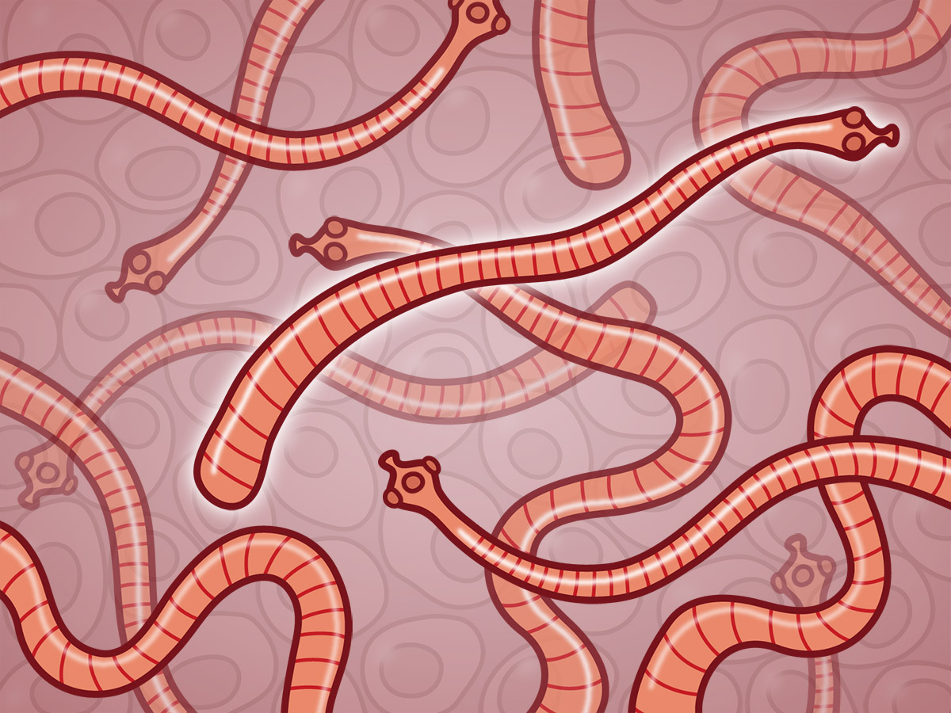
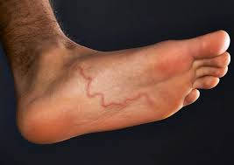
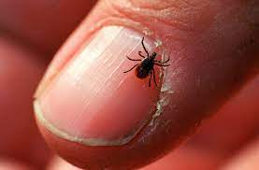
Parasites and Pathogens
Parasite: an organism that lives in or on another organism and benefits at the expense of others.
Ex: helminths (parasitic worms: tapeworms, roundworms, hookworms), ectoparasites (ticks, fleas)
Notes:
Parasite isPathogen

Slide 24
Parasites and Pathogens
Parasite: an organism that lives in or on another organism and benefits at the expense of others.
Ex: helminths (parasitic worms: tapeworms, roundworms, hookworms), ectoparasites (ticks, fleas)
Pathogen: a microorganism that can cause disease
Ex: bacterium, virus, protozoan
Notes:
Parasite isPathogen

Slide 25
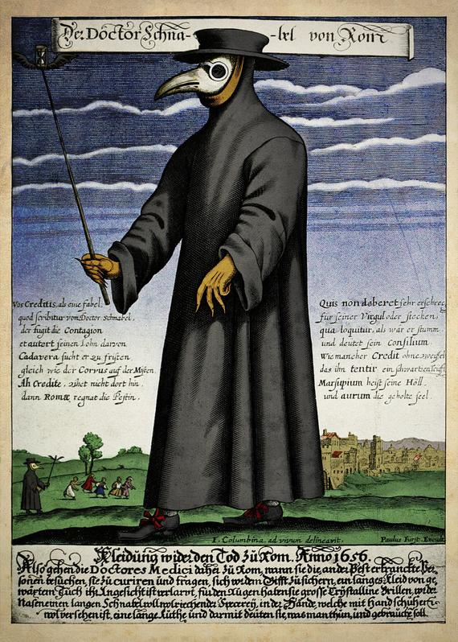
Parasites and Pathogens
Parasite: an organism that lives in or on another organism and benefits at the expense of others.
Ex: helminths (parasitic worms: tapeworms, roundworms, hookworms), ectoparasites (ticks, fleas)
Pathogen: a microorganism that can cause disease
Ex: bacterium, virus, protozoan
Pathogen: Yersinia pestis
Disease: Plague
Notes:
Parasite isPathogen

Slide 26
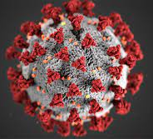
Parasites and Pathogens
Parasite: an organism that lives in or on another organism and benefits at the expense of others.
Ex: helminths (parasitic worms: tapeworms, roundworms, hookworms), ectoparasites (ticks, fleas)
Pathogen: a microorganism that can cause disease
Ex: bacterium, virus, protozoan
Pathogen: Yersinia pestis
Disease: Plague
Pathogen: SARS-CoV-2
Disease: COVID-19
Notes:
Parasite isPathogen

Slide 27
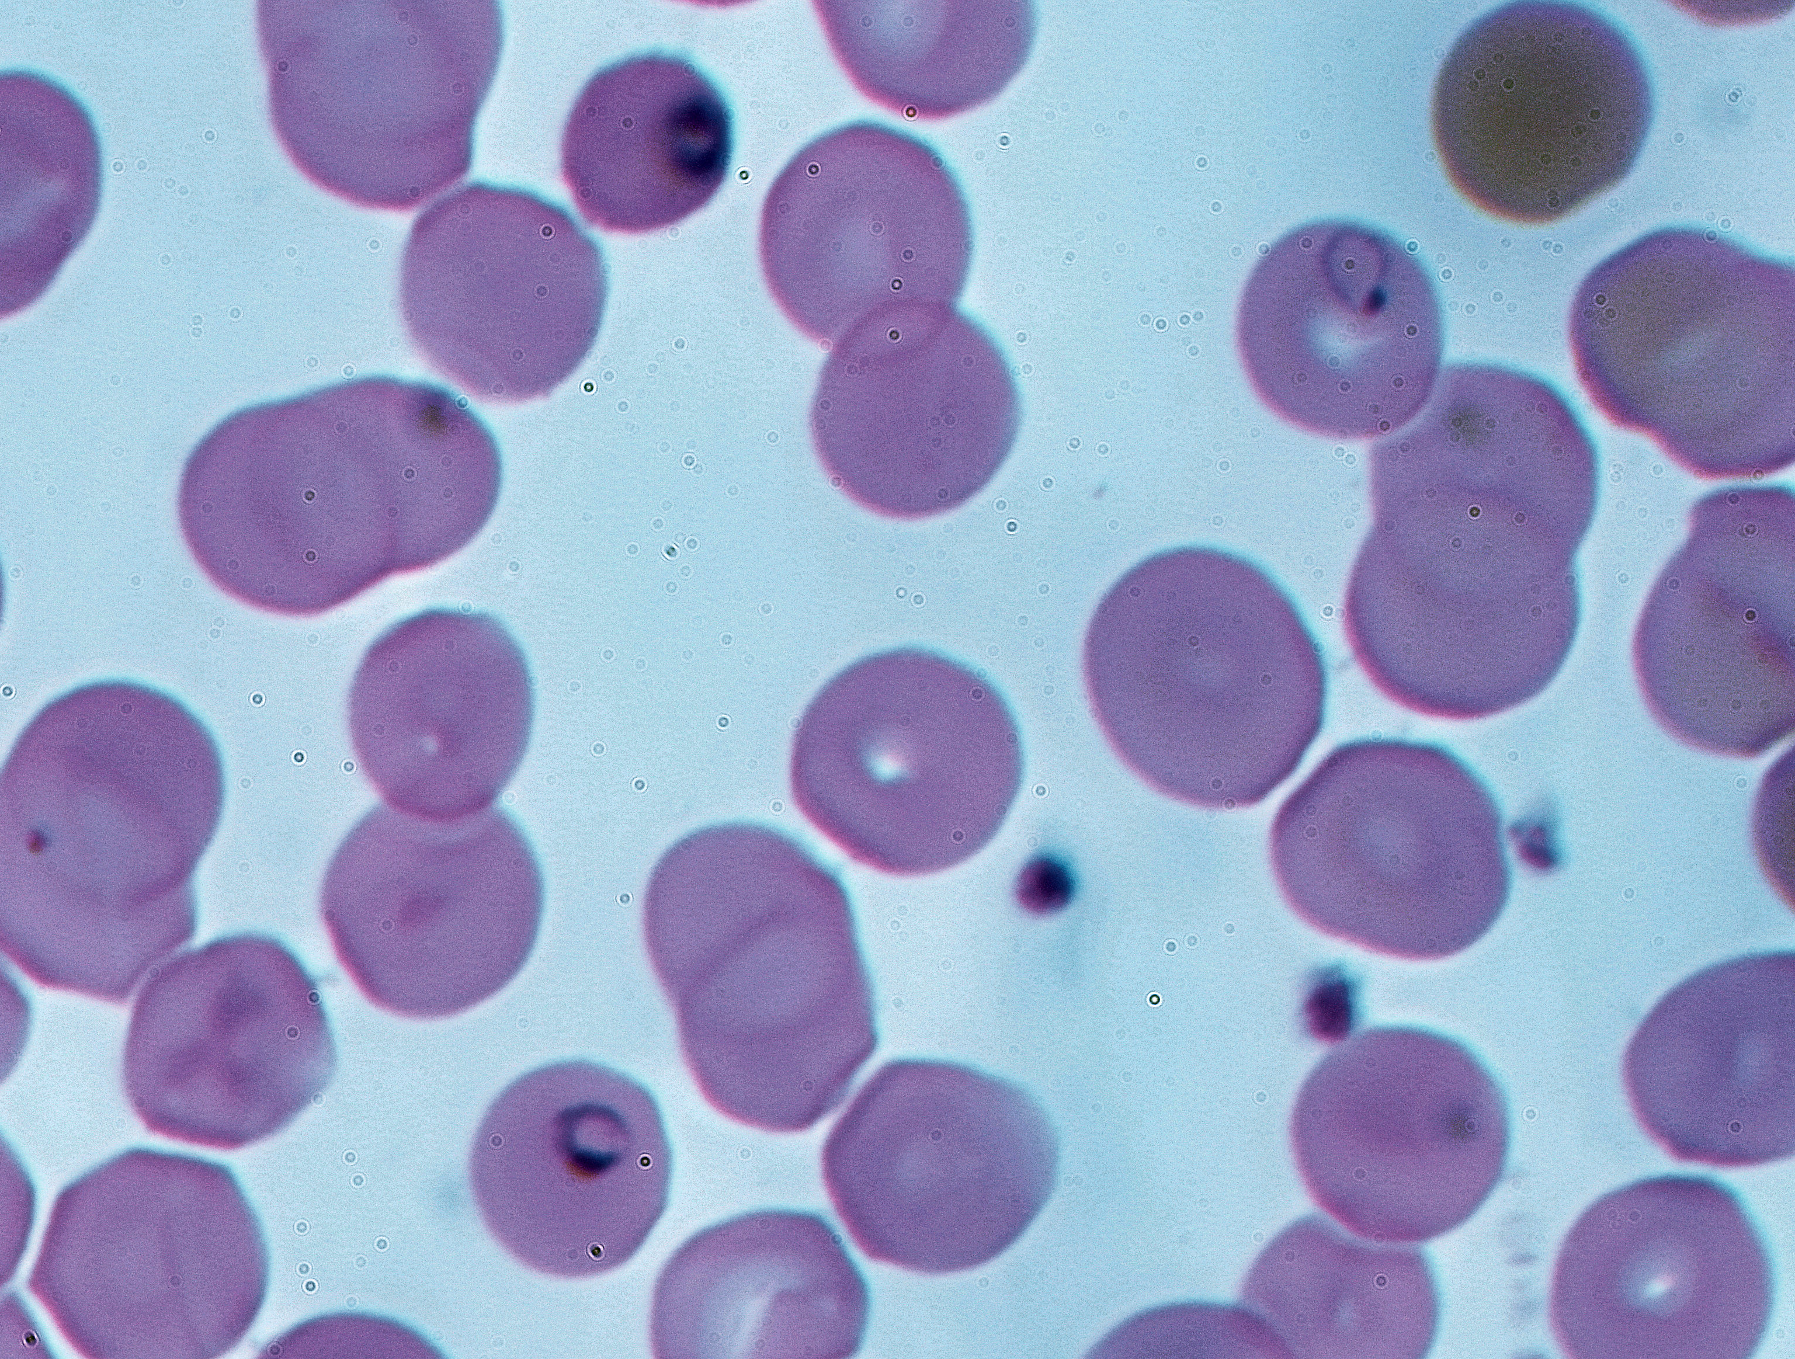
Parasites and Pathogens
Parasite: an organism that lives in or on another organism and benefits at the expense of others.
Ex: helminths (parasitic worms: tapeworms, roundworms, hookworms), ectoparasites (ticks, fleas)
Pathogen: a microorganism that can cause disease
Ex: bacterium, virus, protozoan
Pathogen: Yersinia pestis
Disease: Plague
Pathogen: Plasmodium falciparum, P. vivax, P. malariae, P. ovale, P. knowlesi
Disease: malaria
Pathogen: SARS-CoV-2
Disease: COVID-19
Notes:
Parasite isPathogen

Slide 28
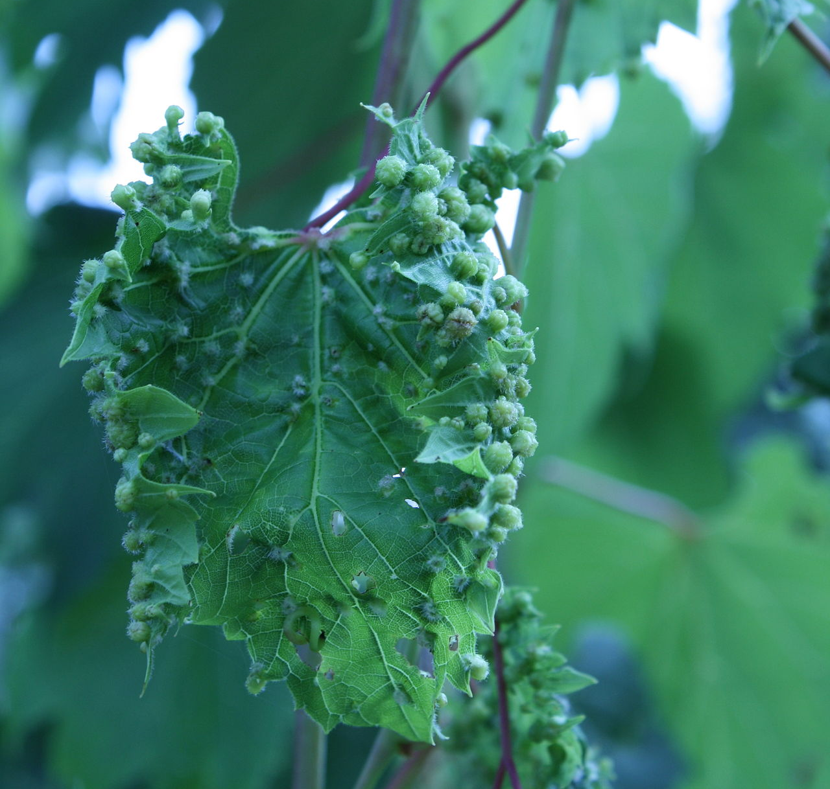
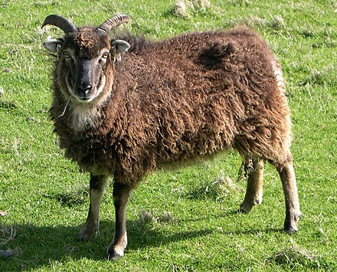
Parasites and Pathogens
Parasite: an organism that lives in or on another organism and benefits at the expense of others.
Ex: helminths (parasitic worms: tapeworms, roundworms, hookworms), ectoparasites (ticks, fleas)
Pathogen: a microorganism that can cause disease
Ex: bacterium, virus, protozoan
Host: the organism on/in which the parasite/pathogen lives
Ex: Soay sheep, grapes
Notes:
Parasite isPathogen

Slide 29
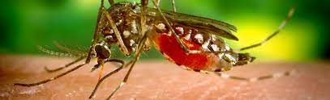
Parasites and Pathogens
Parasite: an organism that lives in or on another organism and benefits at the expense of others.
Ex: helminths (parasitic worms: tapeworms, roundworms, hookworms), ectoparasites (ticks, fleas)
Pathogen: a microorganism that can cause disease
Ex: bacterium, virus, protozoan
Host: the organism on/in which the parasite/pathogen lives
Ex: Soay sheep, grapes
Vector: an arthropod agent that carries and transmits a pathogen or parasite from host to host
Ex: mosquitoes, ticks, fleas
Notes:
Parasite isPathogen

Slide 30
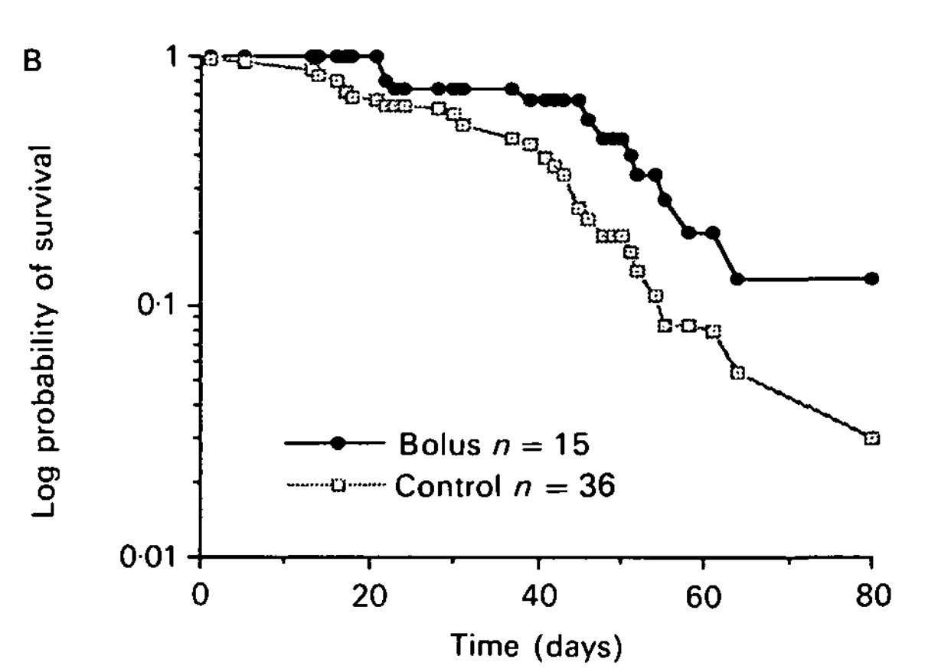
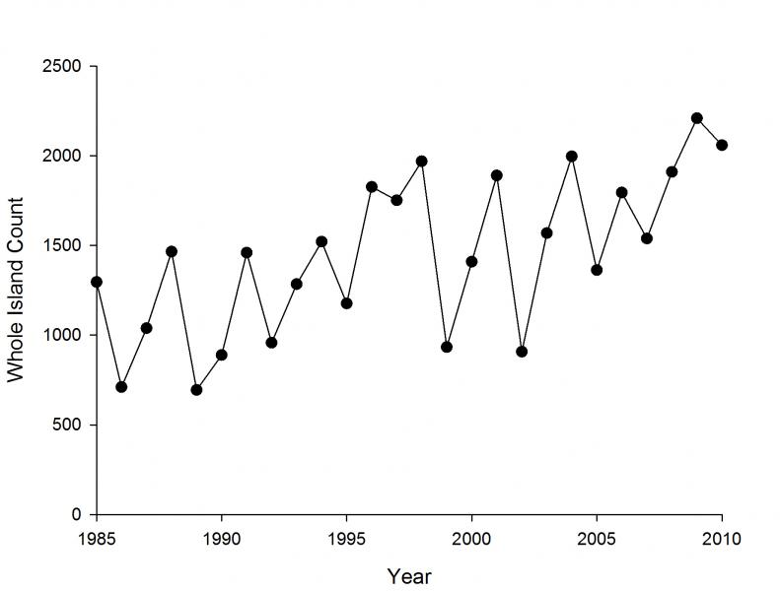
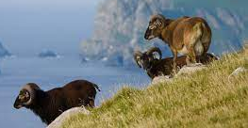
We already know that parasites can play a role in regulating populations!
male juveniles with nematodes
male juveniles treated with antihelminthic
Soay Sheep of St. Kilda, Scotland
Gulland 1992. Parasitology.

Slide 31
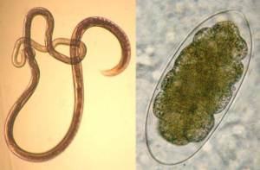
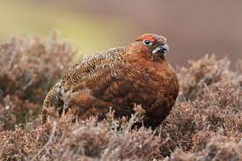
Early work in red grouse experimentally demonstrated the power of parasites to regulate populations.
Hudson 1986. J Animal Ecology.
Hudson et al 1992. J Animal Ecology.
Hudson et al 1998. Science.

Slide 32
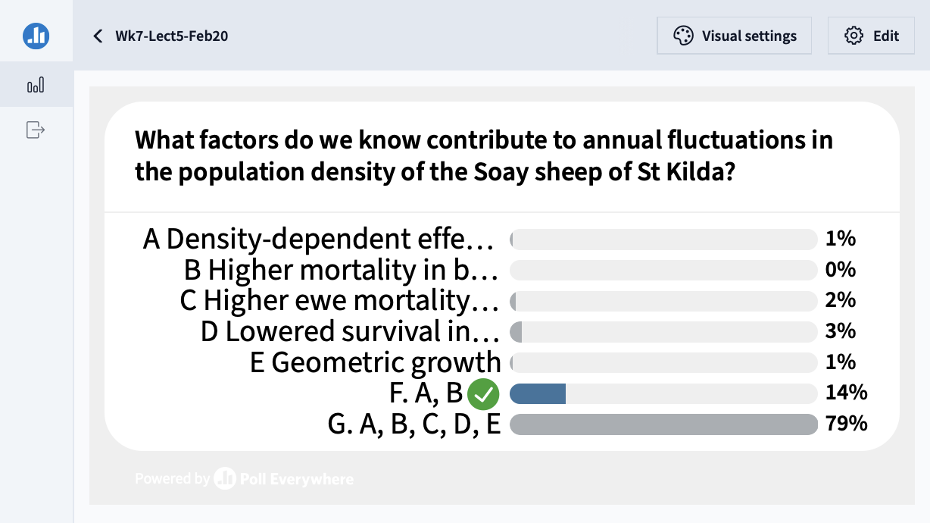

Slide 33
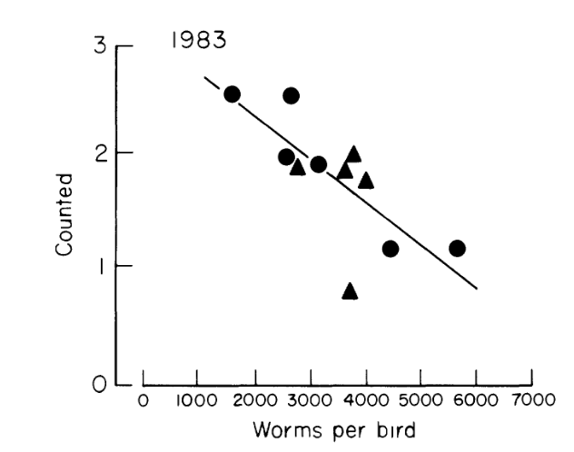
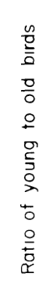
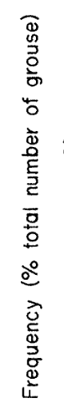
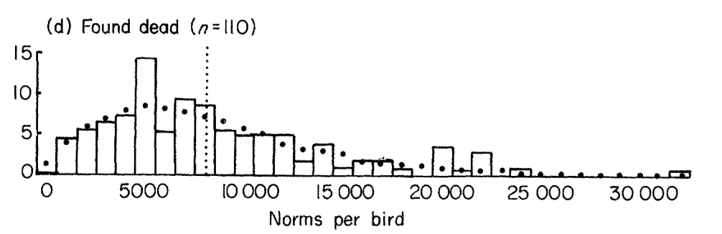
Early work in red grouse experimentally demonstrated the power of parasites to regulate populations.
Higher burden of the intestinal strongyle worm, Trichostrongylus tenuis, both reduces breeding success and increases mortality in red grouse.
Hudson 1986. J Animal Ecology.
Hudson et al 1992. J Animal Ecology.

Slide 34
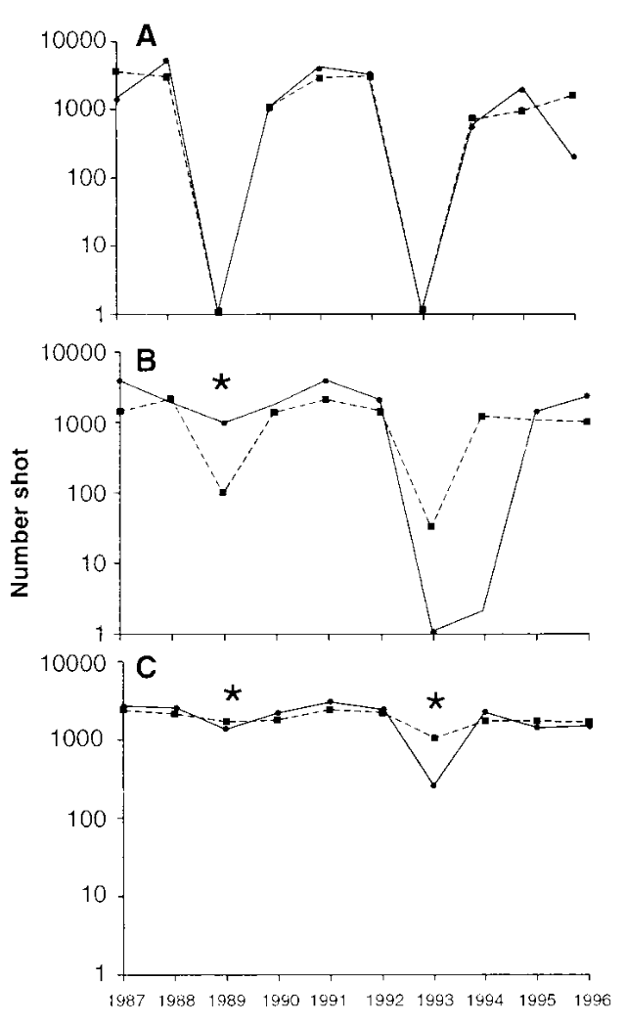
Worms were hypothesized to be responsible for the observed population cycles in ‘bag data’ from northern England.
Hudson et al 1998. Science.

Slide 35
Deworming eliminated population cycles to prove this effect!
Hudson et al 1998. Science.
Notes:
Population changes of red grouse, as represented through bag records in (A) the two control sites, (B) the two populations with a single treatment each, and (C) the two populations with two treatments each. Asterisks represent the years of treatment when worm burdens in adult grouse were reduced.

Slide 36
Parasites and pathogens have also shaped human history.
Notes:
Parasite isPathogen

Slide 37
Parasites and pathogens have also shaped human history.
But we have not always known they were responsible for disease!
Notes:
Parasite isPathogen

Slide 38
Parasites and pathogens have also shaped human history.
But we have not always known they were responsible for disease!
Four Humors: Hippocrates (c. 400 BC) wrote that disease results from an imbalance of the four humors
Notes:
Parasite isPathogen

Slide 39
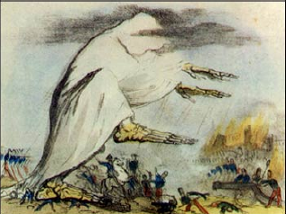
Parasites and pathogens have also shaped human history.
But we have not always known they were responsible for disease!
Four Humors: Hippocrates (c. 400 BC) wrote that disease results from an imbalance of the four humors
Miasmatic Theory: Extension of Hippocrates that lasted through the 1800s – idea that disease was caused by bad air. Popularized by Florence Nightengale
Notes:
Parasite isPathogen

Slide 40
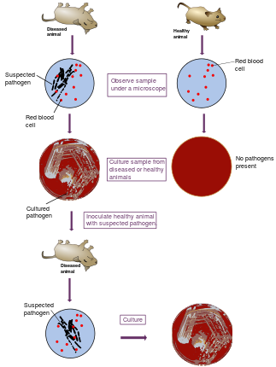
Parasites and pathogens have also shaped human history.
But we have not always known they were responsible for disease!
Four Humors: Hippocrates (c. 400 BC) wrote that disease results from an imbalance of the four humors
Miasmatic Theory: Extension of Hippocrates that lasted through the 1800s – idea that disease was caused by bad air.
Popularized by Florence Nightengale
Germ Theory of Disease: Idea that disease results from germs
Leuwenhoek’s microscope (1675)
Koch’s postulates (1890)
Notes:
Parasite isPathogen

Slide 41
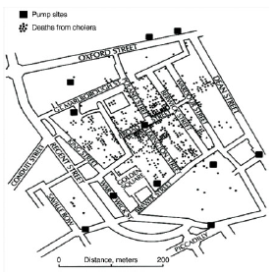
Parasites and pathogens have also shaped human history.
But we have not always known they were responsible for disease!
Four Humors: Hippocrates (c. 400 BC) wrote that disease results from an imbalance of the four humors
Miasmatic Theory: Extension of Hippocrates that lasted through the 1800s – idea that disease was caused by bad air.
Popularized by Florence Nightengale
Germ Theory of Disease: Idea that disease results from germs
Leuwenhoek’s microscope (1675)
Koch’s postulates (1890)
Classic epidemiology
Risk factors for disease = John Snow (1854)
Notes:
Parasite isPathogen

Slide 42
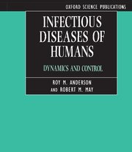
Parasites and pathogens have also shaped human history.
Four Humors: Hippocrates (c. 400 BC) wrote that disease results from an imbalance of the four humors
Miasmatic Theory: Extension of Hippocrates that lasted through the 1800s – idea that disease was caused by bad air.
Popularized by Florence Nightengale
Germ Theory of Disease: Idea that disease results from germs
Leuwenhoek’s microscope (1675)
Koch’s postulates (1890)
Classic epidemiology
Risk factors for disease = understand patterns
Population biology of infectious disease
Understanding the process of infectious disease transmission. = Kermack and McKendrick (1927); Anderson and May (1991).

Slide 43
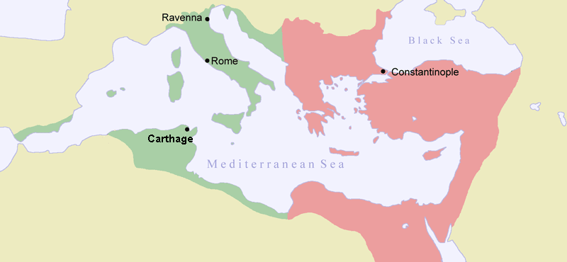
Parasites and pathogens have also shaped human history.
Plague of Justinian (541-549 AD)
First historically recorded pandemic of Yersinia pestis
Launched the ‘first plague pandemic’ resulting in the deaths of 15-100 million people, 25-60% of Europe’s population at the time
Notes:
Parasite is an organism that lives in or on another organism and benefits at the expense of others.
Pathogen

Slide 44
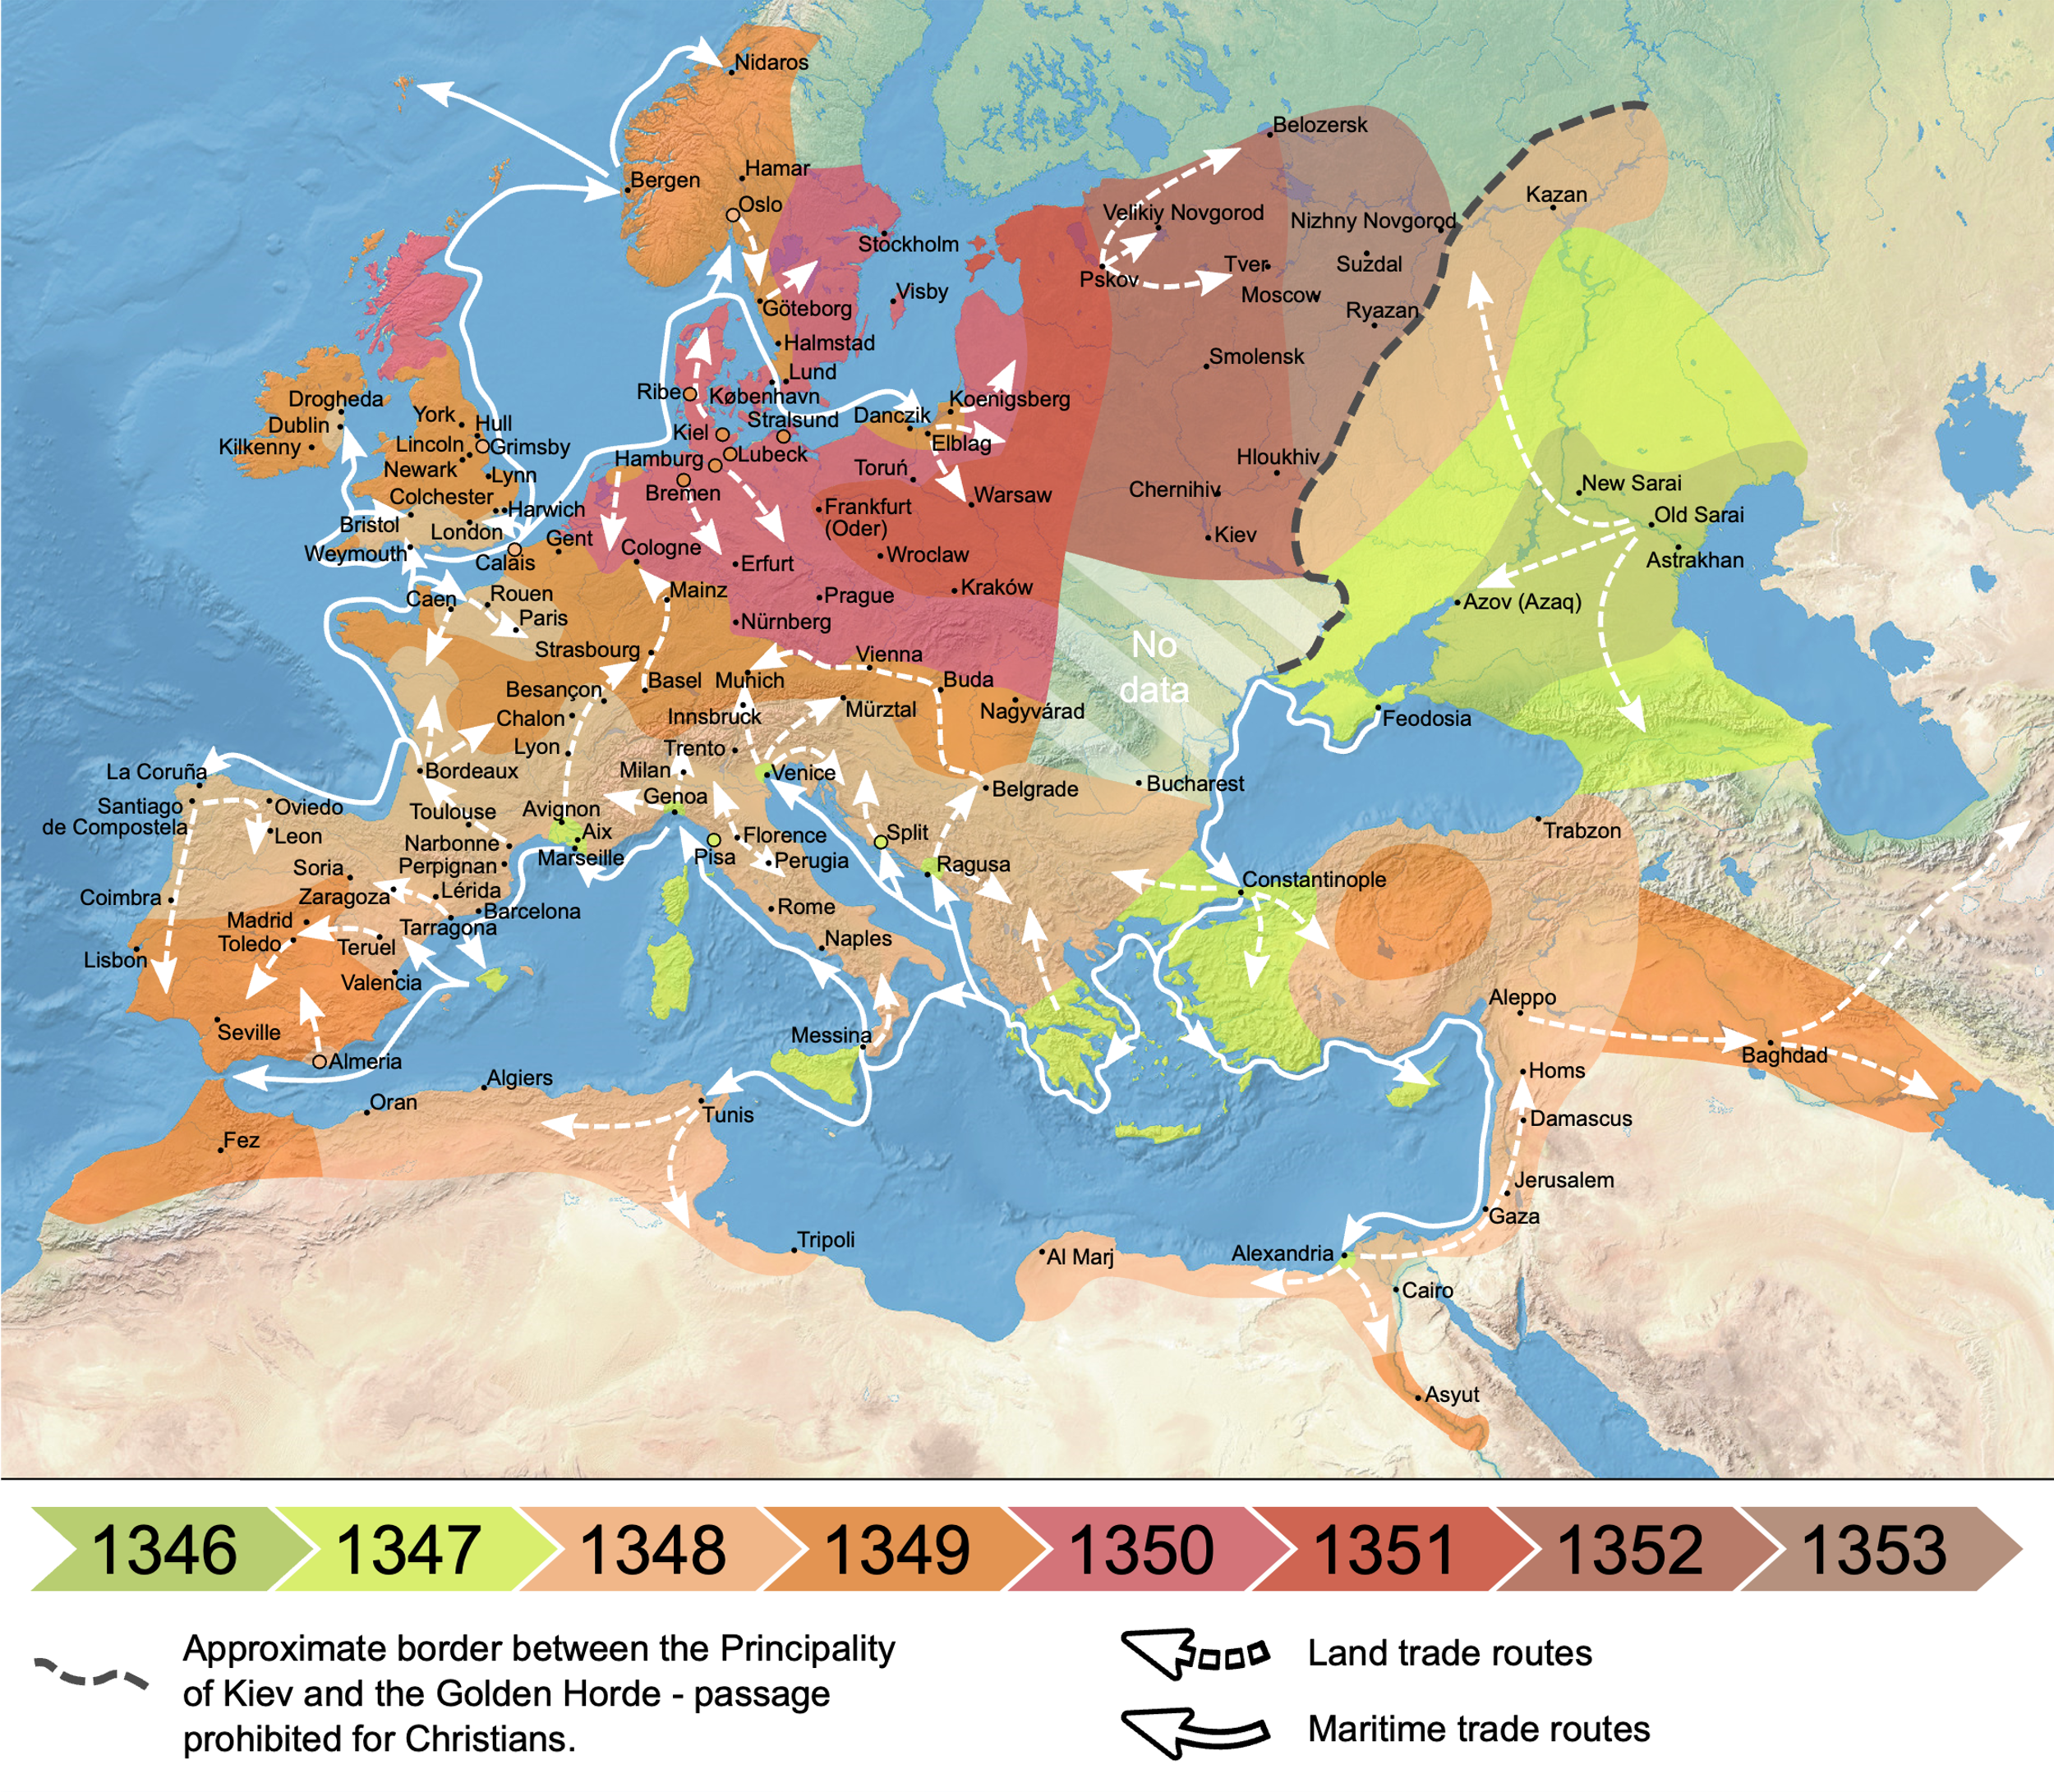
Parasites and pathogens have also shaped human history.
Plague of Justinian (541-549 AD)
Black Death (1346-1353 AD)
Most fatal pandemic in human history, resulting in deaths of 75-200 million people
Killed 30-60% of Europe’s population at the time; 17-54% of global population
Notes:
By Flappiefh - Own work from:Natural Earth ;The origin and early spread of the Black Death in Italy: first evidence of plague victims from 14th-century Liguria (northern Italy) maps by O.J. Benedictow., CC BY-SA 4.0, https://commons.wikimedia.org/w/index.php?curid=66468361

Slide 45

Parasites and pathogens have also shaped human history.
Plague of Justinian (541-549 AD)
Black Death (1346-1353 AD)
Cocoliztli (1545-1548)
Pathogen still unknown! Maybe viral hemorrhagic fever, maybe bacterium
Killed 80% of the population of Mexico
Notes:
By Flappiefh - Own work from:Natural Earth ;The origin and early spread of the Black Death in Italy: first evidence of plague victims from 14th-century Liguria (northern Italy) maps by O.J. Benedictow., CC BY-SA 4.0, https://commons.wikimedia.org/w/index.php?curid=66468361

Slide 46

Parasites and pathogens have also shaped human history.
Plague of Justinian (541-549 AD)
Black Death (1346-1353 AD)
Cocoliztli (1545-1548)
Spanish Influenza (1918-1920)
17-100 million deaths worldwide.
1-5% of global population
2nd-most devastating pandemic in history (after Black Death)
Notes:
The pandemic broke out near the end of World War I, when wartime censors in the belligerent countries suppressed bad news to maintain morale, but newspapers freely reported the outbreak in neutral Spain, creating a false impression of Spain as the epicenter and leading to the "Spanish flu" misnomer.[

Slide 47


Parasites and pathogens have also shaped human history.
Plague of Justinian (541-549 AD)
Black Death (1346-1353 AD)
Cocoliztli (1545-1548)
Spanish Influenza (1918-1920)
HIV (~1960-now)
>40 million deaths and counting
Prevalence still >20% in some countries in southern Africa

Slide 48

Parasites and pathogens have also shaped human history.
Plague of Justinian (541-549 AD)
Black Death (1346-1353 AD)
Cocoliztli (1545-1548)
Spanish Influenza (1918-1920)
HIV (~1960-now)
COVID-19 (2019-2022)
~7-29 million deaths worldwide
~0.1-0.4% of population
Notes:
According to a UNAIDS dataset sourced from the World Bank, in 2019 the HIV prevalence rate for adults aged 15 to 49 was 27% in Eswatini (Swaziland), 25% in Lesotho, 25% in Botswana and 19% in South Africa.^{[1]}

Slide 49
Parasites and pathogens have also shaped human DNA.
Notes:
The way in which sickle cell protects against malaria is attributed to several different things. One of the more common explanations is that the sickle hemoglobin inhibits the plasmodium parasite from infecting the red blood cells which reduces the number of malaria parasites to infect the host. Another factor is the production of heme oxygenase-1 (HO-1) enzyme, which is highly present in the sickle hemoglobin. This enzyme produces carbon monoxide which has been proven to protect against cerebral malaria
Normally, a person inherits two copies of the gene that produces beta-globin, a protein needed to produce normal hemoglobin (hemoglobin A, genotype AA). A person with sickle cell trait inherits one normal allele and one abnormal allele encoding hemoglobin S (hemoglobin genotype AS)
The sickle cell trait can be used to demonstrate the concepts of co-dominance and incomplete dominance. An individual with the sickle cell trait shows incomplete dominance when the shape of the red blood cell is considered. This is because the sickling happens only at low oxygen concentrations. With regards to the actual concentration of hemoglobin in the circulating cells, the alleles demonstrate co-dominance as both 'normal' and mutant forms co-exist in the bloodstream. Thus it is an ambiguous condition showing both incomplete dominance and co-dominance
2021, there were an estimated 247 million cases of malaria worldwide.
The estimated number of malaria deaths stood at 619 000 in 2021.
The WHO African Region carries a disproportionately high share of the global malaria burden. In 2021, the region was home to 95% of malaria cases and 96% of malaria deaths. Children under 5 accounted for about 80% of all malaria deaths in the Region.

Slide 50

Parasites and pathogens have also shaped human DNA.
Sickle cell anemia
The HbS allele confers resistance to malaria but also results in sickle cell anemia when homozygous.
Natural selection has favored this trait in malaria-endemic regions of the planet.
As of 2021, WHO estimates 247 million malaria cases worldwide and >600,000 deaths, 95% in Africa.
Children <5 account for 80% of malaria deaths.
Piel et al 2010. Nature Communications.
Notes:
The way in which sickle cell protects against malaria is attributed to several different things. One of the more common explanations is that the sickle hemoglobin inhibits the plasmodium parasite from infecting the red blood cells which reduces the number of malaria parasites to infect the host. Another factor is the production of heme oxygenase-1 (HO-1) enzyme, which is highly present in the sickle hemoglobin. This enzyme produces carbon monoxide which has been proven to protect against cerebral malaria
Normally, a person inherits two copies of the gene that produces beta-globin, a protein needed to produce normal hemoglobin (hemoglobin A, genotype AA). A person with sickle cell trait inherits one normal allele and one abnormal allele encoding hemoglobin S (hemoglobin genotype AS)
The sickle cell trait can be used to demonstrate the concepts of co-dominance and incomplete dominance. An individual with the sickle cell trait shows incomplete dominance when the shape of the red blood cell is considered. This is because the sickling happens only at low oxygen concentrations. With regards to the actual concentration of hemoglobin in the circulating cells, the alleles demonstrate co-dominance as both 'normal' and mutant forms co-exist in the bloodstream. Thus it is an ambiguous condition showing both incomplete dominance and co-dominance
2021, there were an estimated 247 million cases of malaria worldwide.
The estimated number of malaria deaths stood at 619 000 in 2021.
The WHO African Region carries a disproportionately high share of the global malaria burden. In 2021, the region was home to 95% of malaria cases and 96% of malaria deaths. Children under 5 accounted for about 80% of all malaria deaths in the Region.

Slide 51


Parasites and pathogens have also shaped human DNA.
Duffy antigen
Modeled distribution of Duffy-negative human population
Required for P. vivax to enter RBCs
Distribution Plasmodium falciparum
Distribution Plasmodium vivax
Guerra et al. 2006. Trends in Parasitology
Howes et al 2011. Nature Communications.

Slide 52
The SIR Model
transmission
recovery
β
γ
S
Susceptible
I
Infectious
R
Recovered
β = transmission rate
γ = recovery rate
Kermack and McKendrick 1927 Proc Roy Soc A
Notes:
We based our epidemic framework is based on the suscetible-infectious-recovered SIR model developed by K and M in 1927

Slide 53





We class hosts into categories of susceptible, infectious, and recovered to model pathogen dynamics.
transmission
recovery
“antibody positive”
“seropositive”
β
γ
S
Susceptible
I
Infectious
R
Recovered
β = transmission rate
γ = recovery rate
Kermack and McKendrick 1927 Proc Roy Soc A
Notes:
We based our epidemic framework is based on the suscetible-infectious-recovered SIR model developed by K and M in 1927

Slide 54



We use computers to simulate systems of equations in the SIR framework.
transmission
recovery
$$\frac{dS}{dt}=−βSI$$
β
γ
S
Susceptible
I
Infectious
R
Recovered
$$\frac{dI}{dt}=βSI−γI$$
$$\frac{dR}{dt}=γI$$
β = transmission rate
γ = recovery rate
Kermack and McKendrick 1927 Proc Roy Soc A
Notes:
We based our epidemic framework is based on the suscetible-infectious-recovered SIR model developed by K and M in 1927

Slide 55


$$R_{o}$$
We use computers to simulate systems of equations in the SIR framework.
is the pathogen basic reproduction number.
transmission
recovery
$$\frac{dS}{dt}=−βSI$$
transmission
β
γ
$$R_{0}=\frac{β}{γ}$$
S
Susceptible
I
Infectious
R
Recovered
recovery
$$\frac{dI}{dt}=βSI−γI$$
$$\frac{dR}{dt}=γI$$
β = transmission rate
γ = recovery rate
Notes:
We based our epidemic framework is based on the suscetible-infectious-recovered SIR model developed by K and M in 1927

Slide 56

$$R_{o}$$
We use computers to simulate systems of equations in the SIR framework.
is the pathogen basic reproduction number.
transmission
recovery
$$\frac{dS}{dt}=−βSI$$
infections created
β
γ
$$R_{0}=\frac{β}{γ}$$
S
Susceptible
I
Infectious
R
Recovered
infections lost
$$\frac{dI}{dt}=βSI−γI$$
R₀ must be >1 for a disease to start spreading!
$$\frac{dR}{dt}=γI$$
β = transmission rate
γ = recovery rate
Notes:
We based our epidemic framework is based on the suscetible-infectious-recovered SIR model developed by K and M in 1927

Slide 57

$$R_{o}$$
The basic reproduction number for a pathogen

Slide 58
$$R_{o}$$
The basic reproduction number for a pathogen
Defined as: the number of new cases caused by one infectious case in a completely susceptible population

Slide 59
$$R_{o}$$
The basic reproduction number for a pathogen
Defined as: the number of new cases caused by one infectious case in a completely susceptible population

Slide 60
$$R_{o}$$
The basic reproduction number for a pathogen
Defined as: the number of new cases caused by one infectious case in a completely susceptible population

Slide 61
$$R_{o}$$
The basic reproduction number for a pathogen
Defined as: the number of new cases caused by one infectious case in a completely susceptible population

Slide 62
$$R_{o}$$
The basic reproduction number for a pathogen
Defined as: the number of new cases caused by one infectious case in a completely susceptible population

Slide 63
$$R_{o}$$
The basic reproduction number for a pathogen
Defined as: the number of new cases caused by one infectious case in a completely susceptible population

Slide 64

$$R_{o}$$
The basic reproduction number for a pathogen
Defined as: the number of new cases caused by one infectious case in a completely susceptible population
What is $R_{o}$?

Slide 65

$$R_{o}$$
The basic reproduction number for a pathogen
Defined as: the number of new cases caused by one infectious case in a completely susceptible population
What is $R_{o}$?
$R_{o}$ = 5

Slide 66



We can add realism to our models with births and deaths to maintain endemic pathogens.
deaths
deaths
deaths
μ
μ
μ
births
transmission
recovery
$$\frac{dS}{dt}=b(S+I+R)−βSI−μS$$
b
β
γ
S
Susceptible
I
Infectious
R
Recovered
$$\frac{dI}{dt}=βSI−γI−μI$$
$$\frac{dR}{dt}=γI−μR$$
b = birth rate
μ = death rate
β = transmission rate
γ = recovery rate
Notes:
We based our epidemic framework is based on the suscetible-infectious-recovered SIR model developed by K and M in 1927

Slide 67
deaths
deaths
deaths
We can estimate epidemic trajectories by fitting SIR models to infectious case count data.
μ
μ
μ
births
transmission
recovery
b
β
γ
S
Susceptible
I
Infectious
R
Recovered
Anderson & May 1991. Infectious Diseases of Humans
Notes:
Often, our data take the form of infectious case counts reporting to hospitals over time.
By adjusting our transmission rate such that our model projection of the number of infectious individuals best reproduces that witnessed in our data, we can project future epidemic trajectories

Slide 68

deaths
deaths
deaths
We can estimate epidemic trajectories by fitting SIR models to infectious case count data.
μ
μ
μ
births
transmission
recovery
b
β
γ
S
Susceptible
I
Infectious
R
Recovered
$$R_{0}=\frac{β}{γ+ μ}$$
b = birth rate
μ = death rate
β = transmission rate
γ = recovery rate
Anderson & May 1991. Infectious Diseases of Humans
Notes:
Often, our data take the form of infectious case counts reporting to hospitals over time.
By adjusting our transmission rate such that our model projection of the number of infectious individuals best reproduces that witnessed in our data, we can project future epidemic trajectories

Slide 69


deaths
deaths
deaths
We can estimate epidemic trajectories by fitting SIR models to infectious case count data.
μ
μ
μ
births
transmission
recovery
b
β
γ
S
Susceptible
I
Infectious
R
Recovered
$$R_{0}=\frac{β}{γ+ μ}$$
b = birth rate
μ = death rate
β = transmission rate
γ = recovery rate
$$R_{E}=R_{0}\frac{S}{N}$$
$≈λ$ for a population model
(epidemics spread @R_{E}>1 and decline @R_{E}<1)
Anderson & May 1991. Infectious Diseases of Humans
Notes:
Often, our data take the form of infectious case counts reporting to hospitals over time.
By adjusting our transmission rate such that our model projection of the number of infectious individuals best reproduces that witnessed in our data, we can project future epidemic trajectories

Slide 70




$$R_{E}$$
$$R_{t}$$
COVID projections for Illinois through March 2022
OR
The effective reproduction number for a pathogen
Defined as: the number of new cases caused by one infectious case in a partially susceptible population
Calculated as R0*proportion susceptible
$$R_{E}=R_{0}\frac{S}{N}$$
Gives a realistic pulse of the current pace of the epidemic!
epiforecasts.io

Slide 71
$$R_{E}$$
$$R_{t}$$
COVID projections for Illinois through March 2022
OR
The effective reproduction number for a pathogen
Defined as: the number of new cases caused by one infectious case in a partially susceptible population
Calculated as R0*proportion susceptible
$$R_{E}=R_{0}\frac{S}{N}$$
Gives a realistic pulse of the current pace of the epidemic!
epiforecasts.io

Slide 72
$$R_{E}$$
$$R_{t}$$
COVID projections for Illinois through March 2022
OR
The effective reproduction number for a pathogen
Defined as: the number of new cases caused by one infectious case in a partially susceptible population
Calculated as R0*proportion susceptible
$$R_{E}=R_{0}\frac{S}{N}$$
Gives a realistic pulse of the current pace of the epidemic!
epiforecasts.io

Slide 73
$$R_{E}$$
$$R_{t}$$
COVID projections for Illinois through March 2022
OR
The effective reproduction number for a pathogen
Defined as: the number of new cases caused by one infectious case in a partially susceptible population
Calculated as R0*proportion susceptible
$$R_{E}=R_{0}\frac{S}{N}$$
Gives a realistic pulse of the current pace of the epidemic!
epiforecasts.io

Slide 74

No matter the dynamics, not everyone gets infected before the epidemic ends!
transmission
recovery
$$\frac{dS}{dt}=−βSI$$
β
γ
S
Susceptible
I
Infectious
R
Recovered
$$\frac{dI}{dt}=βSI−γI$$
Not 1!
$$\frac{dR}{dt}=γR$$
β = transmission rate
γ = recovery rate
Not 0!
Notes:
We based our epidemic framework is based on the suscetible-infectious-recovered SIR model developed by K and M in 1927

Slide 75
No matter the dynamics, not everyone gets infected before the epidemic ends!
transmission
recovery
$$\frac{dS}{dt}=−βSI$$
β
γ
The epidemic does not end because all individuals have been infected and have either died or recovered.
Rather, finding new susceptibles becomes more difficult and R_{E} <1
S
Susceptible
I
Infectious
R
Recovered
$$\frac{dI}{dt}=βSI−γI$$
$$\frac{dR}{dt}=γI$$
β = transmission rate
γ = recovery rate
Notes:
We based our epidemic framework is based on the suscetible-infectious-recovered SIR model developed by K and M in 1927

Slide 76




Public health interventions can be employed to reduce both R₀ and R_{E}
$R_{0}$ interventions
$R_{E}$ interventions
Social distancing
Masking
Limits to gathering sizes
Drugs that shorten the infectious period
Vaccination

Slide 77
Public health interventions can be employed to reduce both R₀ and R_{E}
$R_{0}$ interventions
$R_{E}$ interventions
Social distancing
Masking
Limits to gathering sizes
Drugs that shorten the infectious period
Vaccination

Slide 78

Mathematics of Vaccination
Goal: Reduce $R_{E}<1$by removing individuals from the susceptible population.

Slide 79
Mathematics of Vaccination
Goal: Reduce $R_{E}<1$by removing individuals from the susceptible population.
transmission
recovery
β
γ
S
Susceptible
I
Infectious
R
Recovered
“antibody positive”
“seropositive”
β = transmission rate
γ = recovery rate

Slide 80


Mathematics of Vaccination
Goal: Reduce $R_{E}<1$by removing individuals from the susceptible population.
$$ν$$
vaccination
β
γ
S
Susceptible
I
Infectious
R
Removed
“antibody positive”
“seropositive”
transmission
recovery
β = transmission rate
γ = recovery rate
$ν$ = vaccination rate

Slide 81

Mathematics of Vaccination
Goal: Reduce $R_{E}<1$by removing individuals from the susceptible population.
Because infectious periods tend to be short-lived (depending on the pathogen!), we can theoretically divide the population into two classes: S (susceptible) and V (vaccinated, or immune)
S
Susceptible
exposure
V
Vaccinated or Immune
or
vaccination

Slide 82

Mathematics of Vaccination
Goal: Reduce $R_{E}<1$by removing individuals from the susceptible population.
Because infectious periods tend to be short-lived (depending on the pathogen!), we can theoretically divide the population into two classes: S (susceptible) and V (vaccinated, or immune)
If $S+V=N$, then Prop. Susceptible + Prop. Vaccinated = 1.
S
Susceptible
exposure
V
Vaccinated or Immune
or
vaccination

Slide 83

Mathematics of Vaccination
Goal: Reduce $R_{E}<1$by removing individuals from the susceptible population.
Because infectious periods tend to be short-lived (depending on the pathogen!), we can theoretically divide the population into two classes: S (susceptible) and V (vaccinated, or immune)
If $S+V=N$, then Prop. Susceptible + Prop. Vaccinated = 1.
Remember, $R_{E}={R_{0}P}_{S}$ or $R_{E}=R_{0}\left({1−P}_{V}\right)$
S
Susceptible
exposure
V
Vaccinated or Immune
or
vaccination

Slide 84

Mathematics of Vaccination
Goal: Reduce $R_{E}<1$by removing individuals from the susceptible population.
Because infectious periods tend to be short-lived (depending on the pathogen!), we can theoretically divide the population into two classes: S (susceptible) and V (vaccinated, or immune)
If $S+V=N$, then Prop. Susceptible + Prop. Vaccinated = 1.
Remember, $R_{E}={R_{0}P}_{S}$ or $R_{E}=R_{0}\left({1−P}_{V}\right)$
$R_{E}<1≈ \left({1−P}_{V}\right)R_{0}<1$
S
Susceptible
exposure
V
Vaccinated or Immune
or
vaccination

Slide 85

Mathematics of Vaccination
Goal: Reduce $R_{E}<1$by removing individuals from the susceptible population.
Because infectious periods tend to be short-lived (depending on the pathogen!), we can theoretically divide the population into two classes: S (susceptible) and V (vaccinated, or immune)
If $S+V=N$, then Prop. Susceptible + Prop. Vaccinated = 1.
Remember, $R_{E}={R_{0}P}_{S}$ or $R_{E}=R_{0}\left({1−P}_{V}\right)$
$R_{E}<1≈ \left({1−P}_{V}\right)R_{0}<1$
Rearranging, $P_{V}$ $>1−\frac{1}{R_{0}}$
S
Susceptible
exposure
V
Vaccinated or Immune
or
vaccination

Slide 86

Mathematics of Vaccination
Goal: Reduce $R_{E}<1$by removing individuals from the susceptible population.
Because infectious periods tend to be short-lived (depending on the pathogen!), we can theoretically divide the population into two classes: S (susceptible) and V (vaccinated, or immune)
If $S+V=N$, then Prop. Susceptible + Prop. Vaccinated = 1.
Remember, $R_{E}={R_{0}P}_{S}$ or $R_{E}=R_{0}\left({1−P}_{V}\right)$
$R_{E}<1≈ \left({1−P}_{V}\right)R_{0}<1$
Rearranging, $P_{V}$ $>1−\frac{1}{R_{0}}$
This is the herd immunity threshold.
S
Susceptible
exposure
V
Vaccinated or Immune
or
vaccination

Slide 87

Mathematics of Vaccination
Goal: Reduce $R_{E}<1$by removing individuals from the susceptible population.
Because infectious periods tend to be short-lived (depending on the pathogen!), we can theoretically divide the population into two classes: S (susceptible) and V (vaccinated, or immune)
If $S+V=N$, then Prop. Susceptible + Prop. Vaccinated = 1.
Remember, $R_{E}={R_{0}P}_{S}$ or $R_{E}=R_{0}\left({1−P}_{V}\right)$
$R_{E}<1≈ \left({1−P}_{V}\right)R_{0}<1$
Rearranging, $P_{V}$ $>1−\frac{1}{R_{0}}$
This is the herd immunity threshold.
Even susceptibles will not become infected because the disease will not spread ($R_{E}<1$).
S
Susceptible
exposure
V
Vaccinated or Immune
or
vaccination

Slide 88


$$R_{0}$$
and the Herd Immunity Threshold
Herd immunity threshold (HIT)
The more transmissible the disease, the higher the HIT!

Slide 89


Slide 90

Vaccination stems from a long history
$$ν$$
vaccination
β
γ
S
Susceptible
I
Infectious
R
Removed
“antibody positive”
“seropositive”
transmission
recovery

Slide 91

Vaccination stems from a long history
Variolation: Early attempts to provide protection against smallpox (Variola) via inoculation with scab material from a recent patient infected with Variola minor
First described in China in the 10th century
Caused 1% mortality!
1789 Edward Jenner used cowpox vesicles to inoculate an 8-year-old boy
Later inoculated with smallpox and boy was unaffected
The first vaccine, taken from vacca, cow in Latin
Smallpox was globally eradicated in 1977, following a massive international campaign
Today, we are seeing enhanced transmission of monkeypox partly resulting from a lack of circulating immunity to closely related smallpox

Slide 92
Vaccination stems from a long history
Variolation: Early attempts to provide protection against smallpox (Variola) via inoculation with scab material from a recent patient infected with Variola minor
First described in China in the 10th century
Caused 1% mortality!
1789 Edward Jenner used cowpox vesicles to inoculate an 8-year-old boy
Later inoculated with smallpox and boy was unaffected
The first vaccine, taken from vacca, cow in Latin
Smallpox was globally eradicated in 1977, following a massive international campaign
Today, we are seeing enhanced transmission of monkeypox partly resulting from a lack of circulating immunity to closely related smallpox

Slide 93

Vaccination stems from a long history
Variolation: Early attempts to provide protection against smallpox (Variola) via inoculation with scab material from a recent patient infected with Variola minor
First described in China in the 10th century
Caused 1% mortality!
1789 Edward Jenner used cowpox vesicles to inoculate an 8-year-old boy
Later inoculated with smallpox and boy was unaffected
The first vaccine, taken from vacca, cow in Latin
Smallpox was globally eradicated in 1977, following a massive international campaign
Today, we are seeing enhanced transmission of monkeypox partly resulting from a lack of circulating immunity to closely related smallpox

Slide 94

Vaccination stems from a long history
Variolation: Early attempts to provide protection against smallpox (Variola) via inoculation with scab material from a recent patient infected with Variola minor
First described in China in the 10th century
Caused 1% mortality!
1789 Edward Jenner used cowpox vesicles to inoculate an 8-year-old boy
Later inoculated with smallpox and boy was unaffected
The first vaccine, taken from vacca, cow in Latin
Smallpox was globally eradicated in 1977, following a massive international campaign
Today, we are seeing enhanced transmission of monkeypox partly resulting from a lack of circulating immunity to closely related smallpox

Slide 95

Vaccination stems from a long history
Variolation: Early attempts to provide protection against smallpox (Variola virus) via inoculation with scab material from a recent patient infected with Variola minor
First described in China in the 10th century
Caused 1% mortality!
1789 Edward Jenner used cowpox vesicles to inoculate an 8-year-old boy
Later inoculated with smallpox and boy was unaffected
The first vaccine, taken from vacca, cow in Latin
Smallpox was globally eradicated in 1977, following a massive international campaign
Today, we are seeing enhanced transmission of monkeypox partly resulting from a lack of circulating immunity to closely related smallpox

Slide 96

Only two global vaccination success stories
Notes:
And the second resulted in eradication of rinderpest, a morbillivirus that infects cattle and has decimated agricultural production since antiquity (indeed, rinderpest is thought to have been one of the famed 10 plagues of Egypt and is described in early Roman texts). Rinderpest was declared to be globally eradicated in 2011, though the earliest inoculation efforts date back to the mid-1700s. Vaccine stocks are still held globally because cattle would be highly susceptible to infection were a resurgence to occur. The same is true for smallpox, and recent circulation of monkeypox underlines this susceptibility, as smallpox vaccine is cross-protective.

Slide 97
Only two global vaccination success stories
Rinderpest was globally eradicated in 2011, though inoculation efforts date back to the 1700s!
Notes:
And the second resulted in eradication of rinderpest, a morbillivirus that infects cattle and has decimated agricultural production since antiquity (indeed, rinderpest is thought to have been one of the famed 10 plagues of Egypt and is described in early Roman texts). Rinderpest was declared to be globally eradicated in 2011, though the earliest inoculation efforts date back to the mid-1700s. Vaccine stocks are still held globally because cattle would be highly susceptible to infection were a resurgence to occur. The same is true for smallpox, and recent circulation of monkeypox underlines this susceptibility, as smallpox vaccine is cross-protective.

Slide 98



Remember those trophic cascades…
Estes et al. 2011. Science.
↓ rinderpest
↑ wildebeest
↓ grass
↓ fire
↑ trees
Rinderpest eradication releases wildebeest populations that control savanna, limit fire, and promote tree regrowth
Holdo et al. 2009. PLoS Biology
Notes:
In one of the most famous empirical experiments in ecology, Paine removed the dominant predator, Pisaster from the intertidal ecosystem in Tatoosh Island, WA, In the absence of a predator’s top-down control, the ecosystem

Slide 99

The pace of vaccine development has accelerated drastically

Slide 100
But we still lack vaccines for several important diseases.

Slide 101




Challenges to Vaccination
Imperfect immunity, especially with non-viral pathogens
Geographic differences in public health policy and access
Continuous births
Animal reservoirs
Spatial structure (metapopulation rescue)
$$ν$$
vaccination
β
γ
S
Susceptible
I
Infectious
R
Removed
trans-mission
recov-ery
$$ω$$
waning immunity
β = transmission rate
γ = recovery rate
$ν$ = vaccination rate
$ω$= rate waning immunity
Montoya et al. 2021 Microbiology Spectrum

Slide 102

Challenges to Vaccination
Imperfect immunity, especially with non-viral pathogens
Geographic differences in public health policy and access
Continuous births
Animal reservoirs
Spatial structure (metapopulation rescue)

Slide 103

Challenges to Vaccination
Imperfect immunity, especially with non-viral pathogens
Geographic differences in public health policy and access
Continuous births
Animal reservoirs
Spatial structure (metapopulation rescue)

Slide 104


Challenges to Vaccination
Imperfect immunity, especially with non-viral pathogens
Geographic differences in public health policy and access
Continuous births
Animal reservoirs
Spatial structure (metapopulation rescue)
Swinton et al. 1998
Bartlett 1957

Slide 105
Challenges to Vaccination
Spatial structure (metapopulation rescue)
time until all patches go extinct (remember metapopulations!)
number of patches
number of seals per patch
Swinton et al. 1998
Bartlett 1957

Slide 106
Challenges to Vaccination
Spatial structure (metapopulation rescue)
time until all patches go extinct (remember metapopulations!)
number of patches
All else equal, increasing the number of patches will slow the time to extinction.
…though remember source-sink dynamics!
number of seals per patch
Swinton et al. 1998
Bartlett 1957

Slide 107
Population Biology
Conservation Biology
Disease Ecology
Goal:
protect populations from extinction
Concept:
Minimum Viable Population size (MVP)
Approach:
protected area reserves
Goal:
protect populations from disease via pathogen extinction
Concept:
Critical Community Size (CCS)
Approach:
sanitation
vaccination

Slide 108
Population Biology
Conservation Biology
Disease Ecology
Goal:
protect populations from extinction
Concept:
Minimum Viable Population size (MVP)
Approach:
protected area reserves
Goal:
protect populations from disease via pathogen extinction
Concept:
Critical Community Size (CCS)
Approach:
sanitation
vaccination
MVP = the minimum number of individuals in a population needed to sustain the population 1000 years into the future
CCS = the minimum number of hosts needed to sustain endemic transmission of a pathogen indefinitely into the future

Slide 109
Population Biology
Conservation Biology
Disease Ecology
Goal:
protect populations from extinction
Concept:
Minimum Viable Population size (MVP)
Approach:
protected area reserves
Goal:
protect populations from disease via pathogen extinction
Concept:
Critical Community Size (CCS)
Approach:
sanitation
vaccination

Slide 110
Challenges to Vaccination
Imperfect immunity, especially with non-viral pathogens
Geographic differences in public health policy and access
Continuous births
Animal reservoirs
Spatial structure (metapopulation rescue)
More complex pathogens!

Slide 111

Much of the mathematical theory underlying vaccination was first developed for measles
measles vaccine introduced, 1965
Shift towards more frequent cycling in post-vaccination era. Dynamics more difficult to predict.
model
Biennial cycles in pre-vaccine era measles cases in London
data
Grenfell et al. 2002. Ecological Monographs

Slide 112

Even for measles, stochastic dynamics mean that predictions become more challenging at smaller population sizes.
Grenfell et al. 2002. Ecological Monographs

Slide 113
CCS is the minimum number of hosts needed to sustain endemic transmission of a pathogen indefinitely into the future.
critical community size, (CCS) for measles = ~300,000 individuals
Bartlett 1957. J of Roy Stat Soc.
Grenfell et al. 2002. Ecological Monographs.
Haydon et al. 2002. Emerging Infectious Diseases.

Slide 115
Extra

Slide 116
Epidemiology vs. Disease Ecology
Epidemiology = “the study of what is on the people”
Coined by Spanish physician Villalba in 1802
Emphasis on the study and analysis of the distribution and determinants of health and disease (“risk factors”)
Including chronic diseases!
Often uses cross-sectional data to demonstrate associations of variables with outcome (disease)
More statistical (y=mx+b)
Pattern
Disease Ecology = the study of how a disease spreads
Emphasis on the interactions of organisms with each other and the environment…when interactions result in disease
Emphasis on understanding the transmission dynamics of infectious disease
Typically involves fitting dynamical (population) models to time series data
More mathematical (dN/dt)
Process

Slide 117
Epidemiology vs. Disease Ecology
Epidemiology = “the study of what is on the people”
Coined by Spanish physician Villalba in 1802
Emphasis on the study and analysis of the distribution and determinants of health and disease (“risk factors”)
Including chronic diseases!
Often uses cross-sectional data to demonstrate associations of variables with outcome (disease)
More statistical (y=mx+b)
Pattern
Disease Ecology = the study of how a disease spreads
Emphasis on the interactions of organisms with each other and the environment…when interactions result in disease
Emphasis on understanding the transmission dynamics of infectious disease
Typically involves fitting dynamical (population) models to time series data
More mathematical (dN/dt)
Process

Slide 118
Epidemiology vs. Disease Ecology
Epidemiology = “the study of what is on the people”
Coined by Spanish physician Villalba in 1802
Emphasis on the study and analysis of the distribution and determinants of health and disease (“risk factors”)
Including chronic diseases!
Often uses cross-sectional data to demonstrate associations of variables with outcome (disease)
More statistical (y=mx+b)
Pattern
Disease Ecology = the study of how a disease spreads
Emphasis on the interactions of organisms with each other and the environment…when interactions result in disease
Emphasis on understanding the transmission dynamics of infectious disease
Typically involves fitting dynamical (population) models to time series data
More mathematical (dN/dt)
Process

Slide 119
Epidemiology vs. Disease Ecology
Epidemiology = “the study of what is on the people”
Coined by Spanish physician Villalba in 1802
Emphasis on the study and analysis of the distribution and determinants of health and disease (“risk factors”)
Including chronic diseases!
Often uses cross-sectional data to demonstrate associations of variables with outcome (disease)
More statistical (y=mx+b)
Pattern
Disease Ecology = the study of how a disease spreads
Emphasis on the interactions of organisms with each other and the environment…when interactions result in disease
Emphasis on understanding the transmission dynamics of infectious disease
Typically involves fitting dynamical (population) models to time series data
More mathematical (dN/dt)
Process

Slide 120
Epidemiology vs. Disease Ecology
Epidemiology = “the study of what is on the people”
Coined by Spanish physician Villalba in 1802
Emphasis on the study and analysis of the distribution and determinants of health and disease (“risk factors”)
Including chronic diseases!
Often uses cross-sectional data to demonstrate associations of variables with outcome (disease)
More statistical (y=mx+b)
Pattern
Disease Ecology = the study of how a disease spreads
Emphasis on the interactions of organisms with each other and the environment…when interactions result in disease
Emphasis on understanding the transmission dynamics of infectious disease
Typically involves fitting dynamical (population) models to time series data
More mathematical (dN/dt)
Process

